Slide 1
LAB 7
Using interrupts with C code
Julio César Almada Fuerte
A00226046
ITE

Slide 2
PART 1
Show the numbers 0 to 3 on the Hex displays, when corresponding buttons are pressed.
Use interruptions with the push buttons

Slide 3
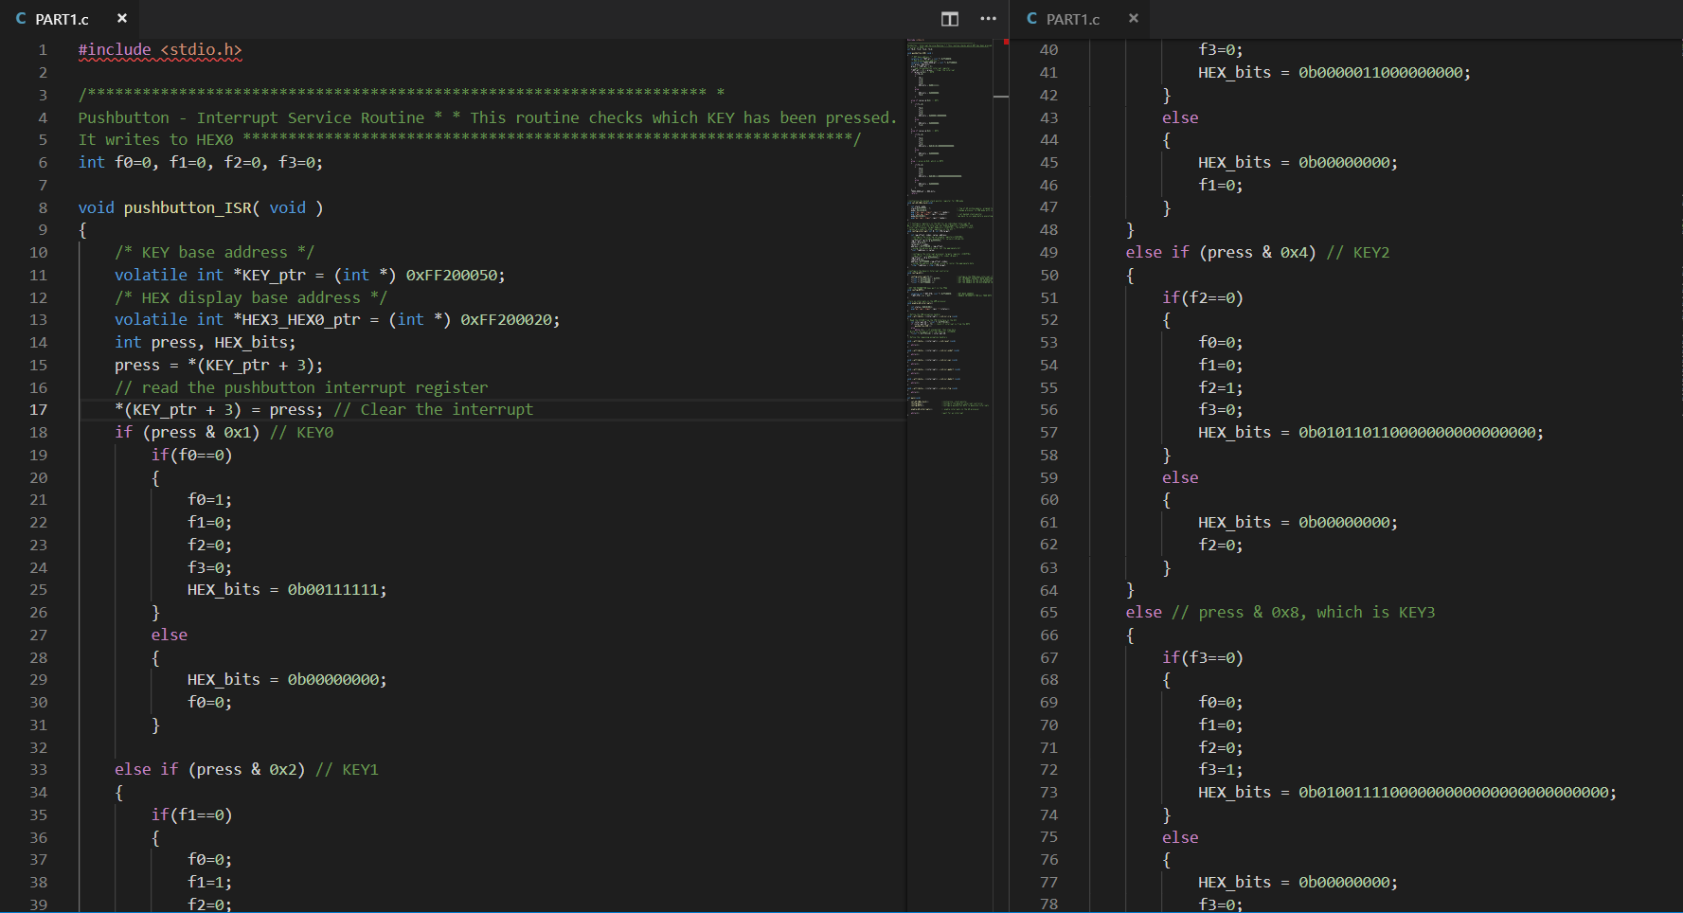

Slide 4
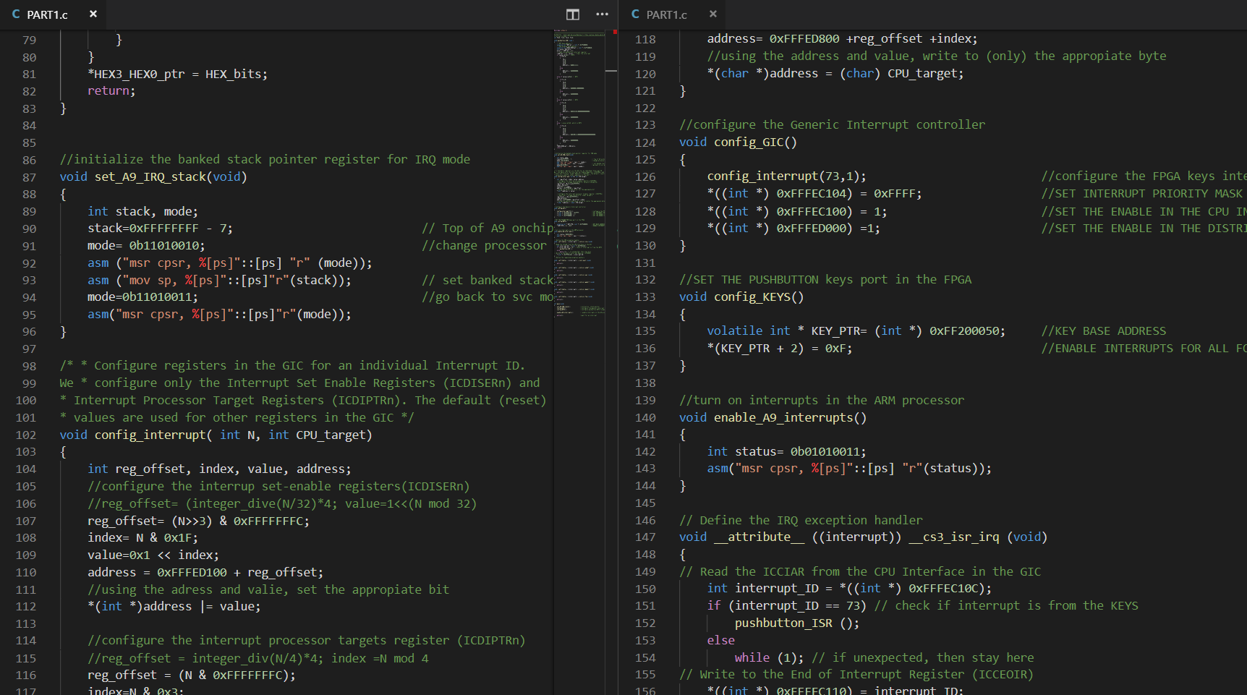

Slide 5
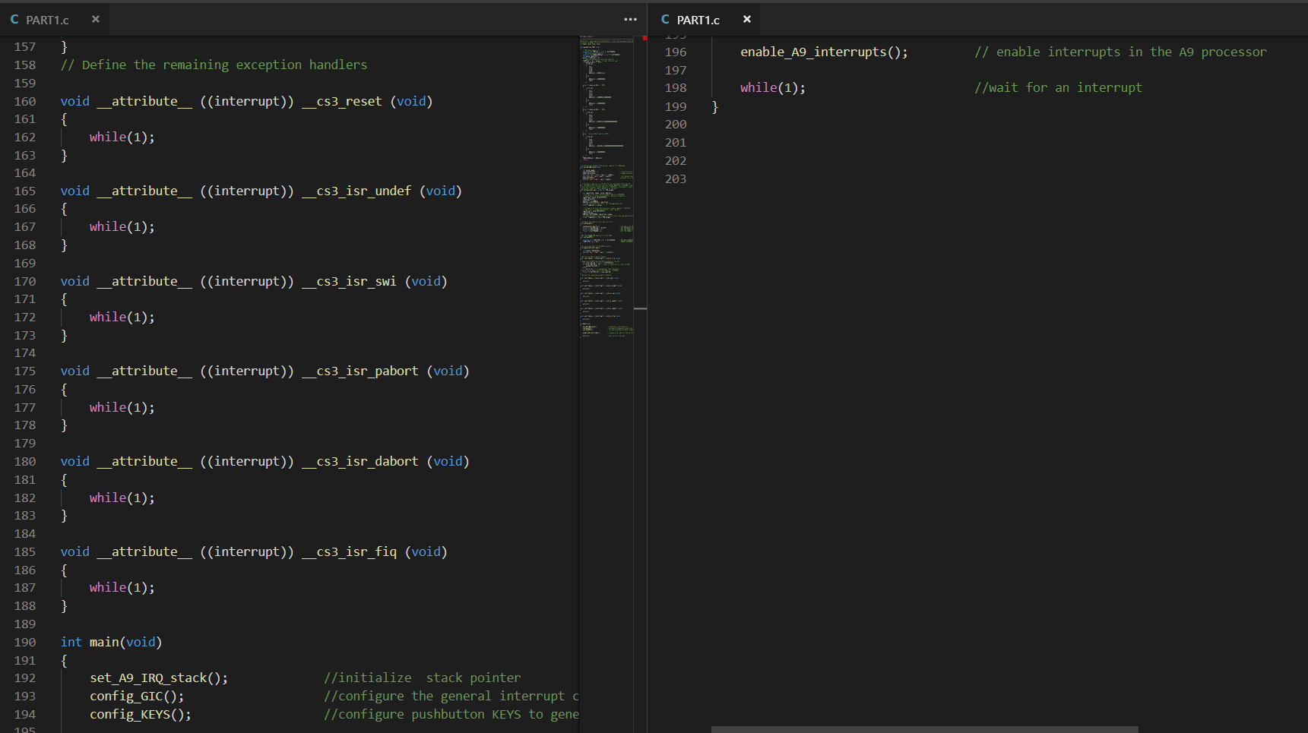

Slide 6
PART 2
Use the interrupts for the HPS timer 0 and the push buttons.
Set the timer to generate one interrupt every .25 seconds.
Write the count variable into the LEDs.
Use the push buttons to run/stop the variable count.

Slide 7
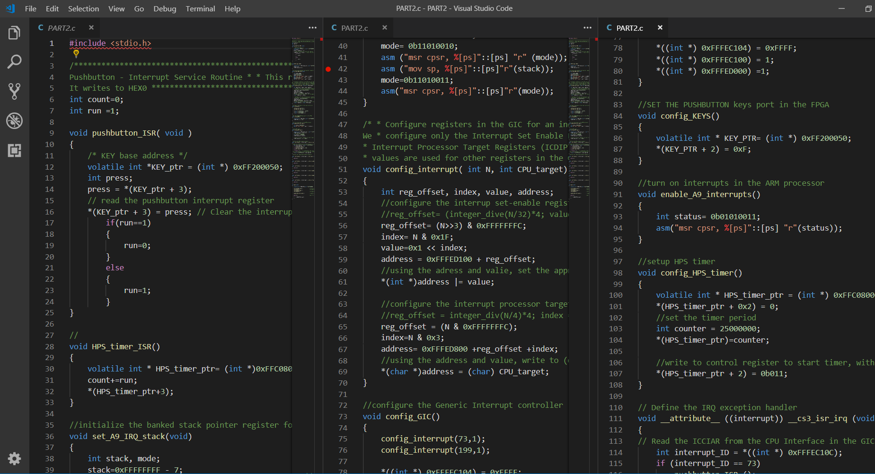

Slide 8
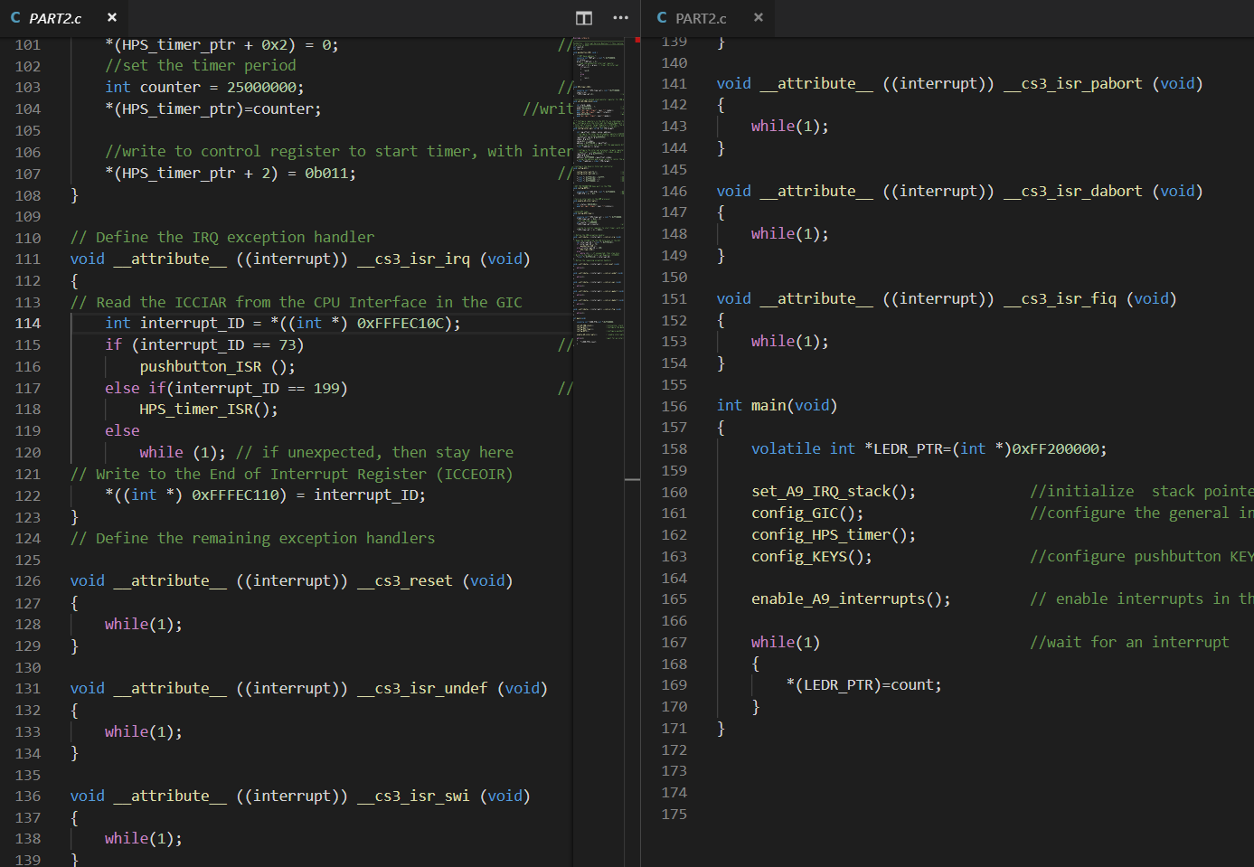

Slide 9
PART 3
Do the same as the last part but control the speed in which the value of counter increments.
Key0: Run/Stop
Key1: Increment
Key2:Decrement

Slide 10
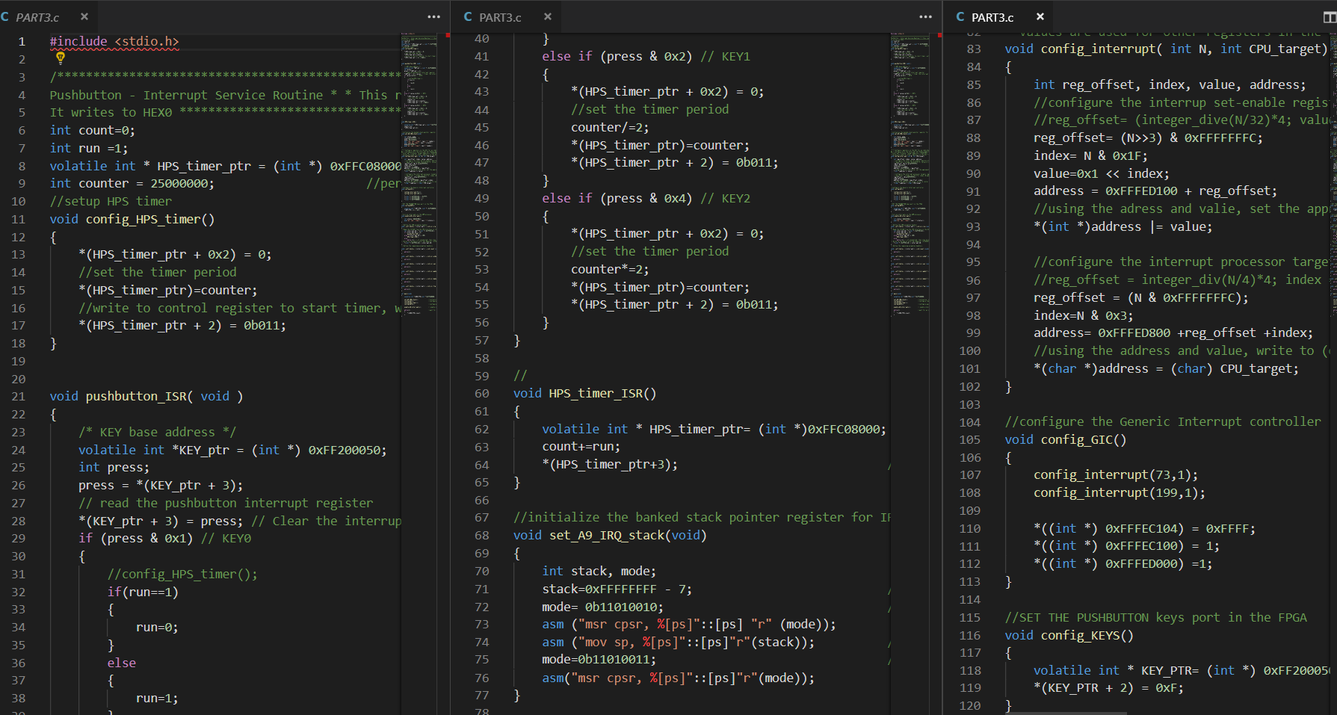

Slide 11
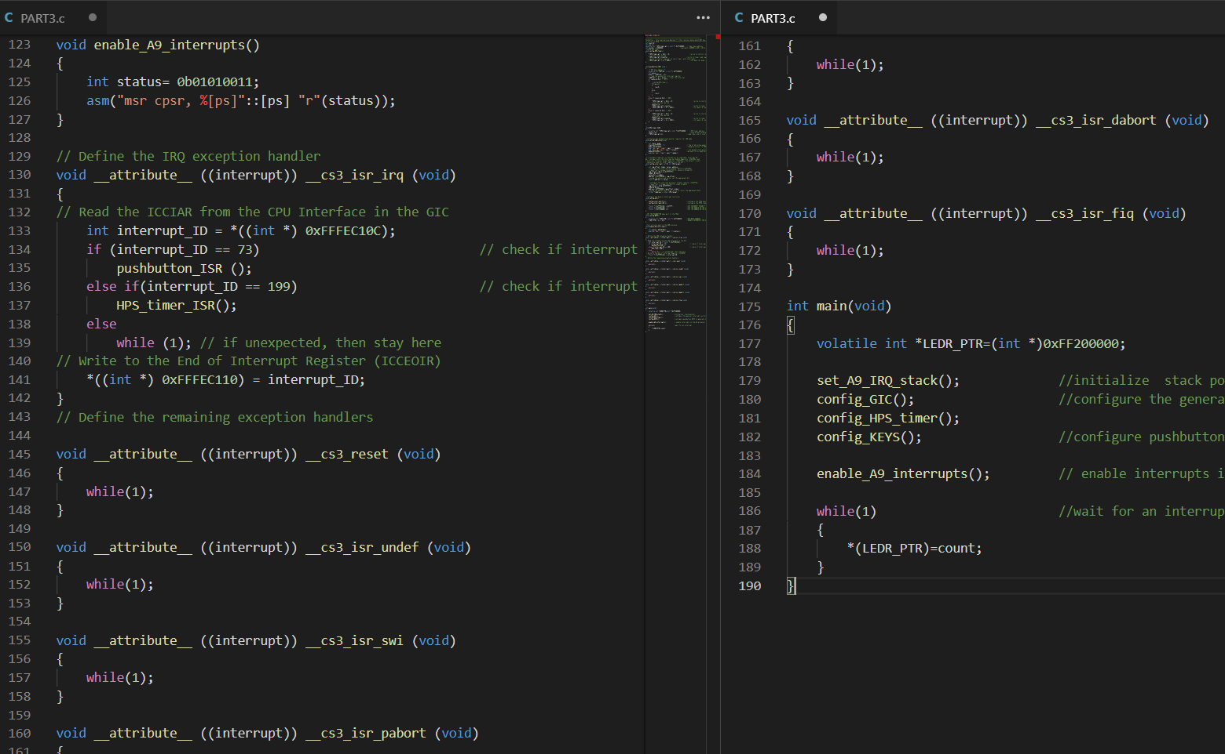

Slide 12
PART 4
To the last part add another source of interrupts: use the A9 private Timer to run a clock on the 7-Segment displays(MM:SS:DD).
Key3: Run/stop the clock.

Slide 13
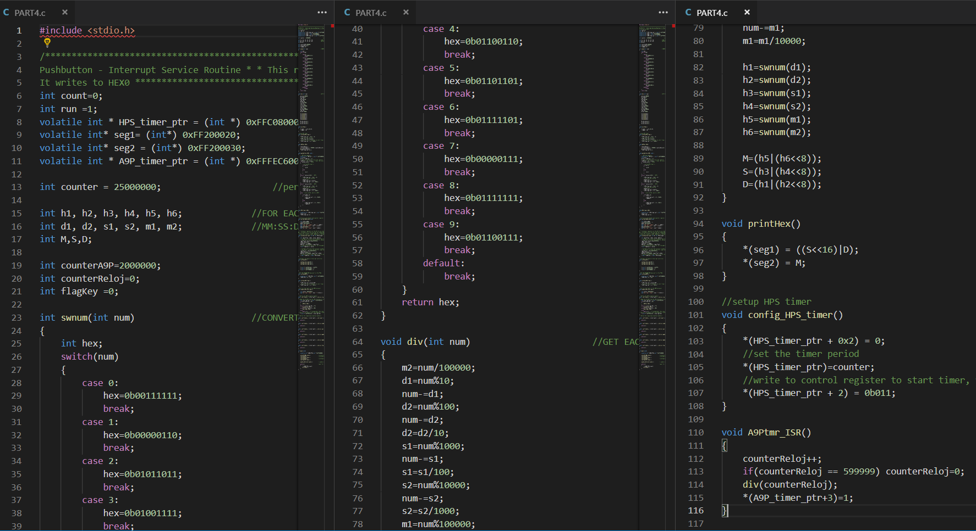

Slide 14
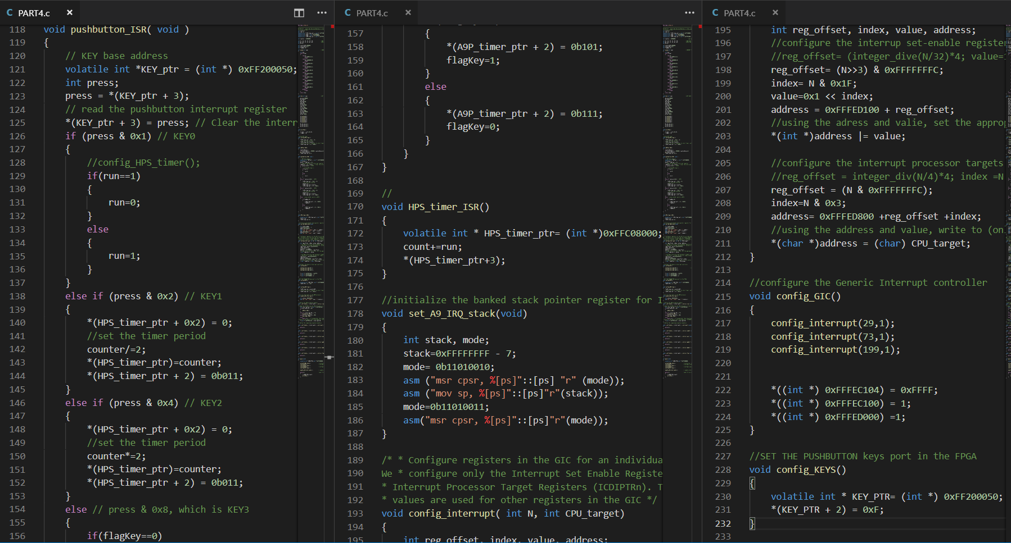

Slide 15
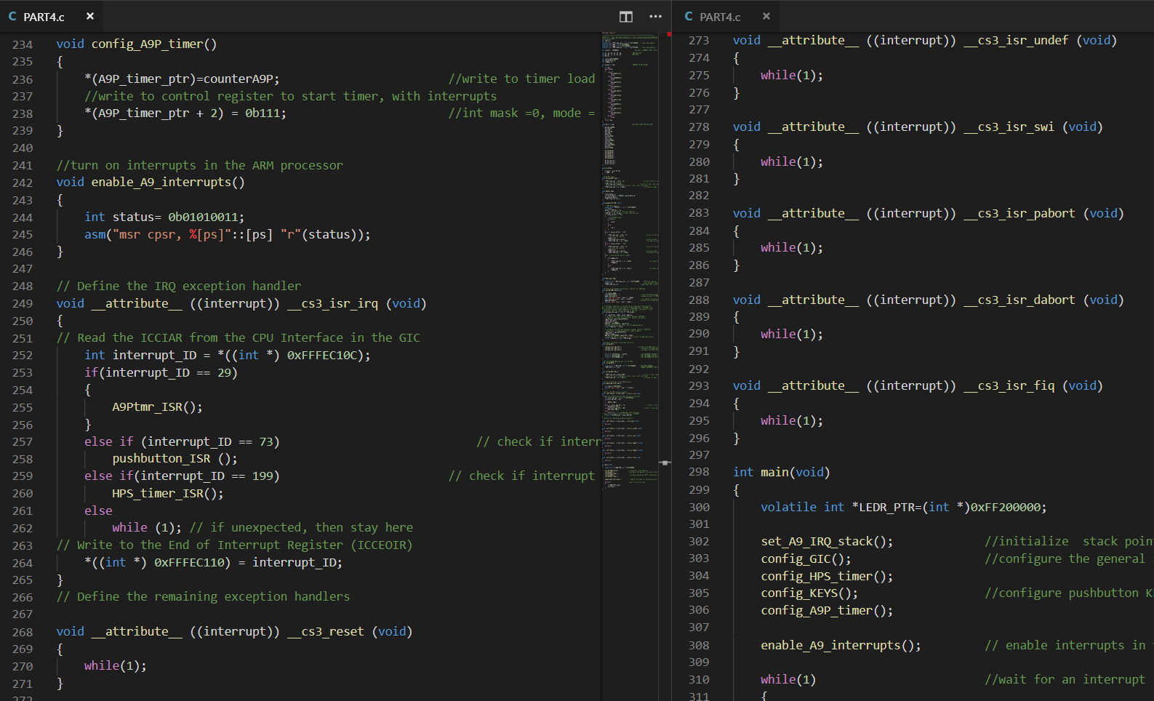

Slide 16
